Slide 1
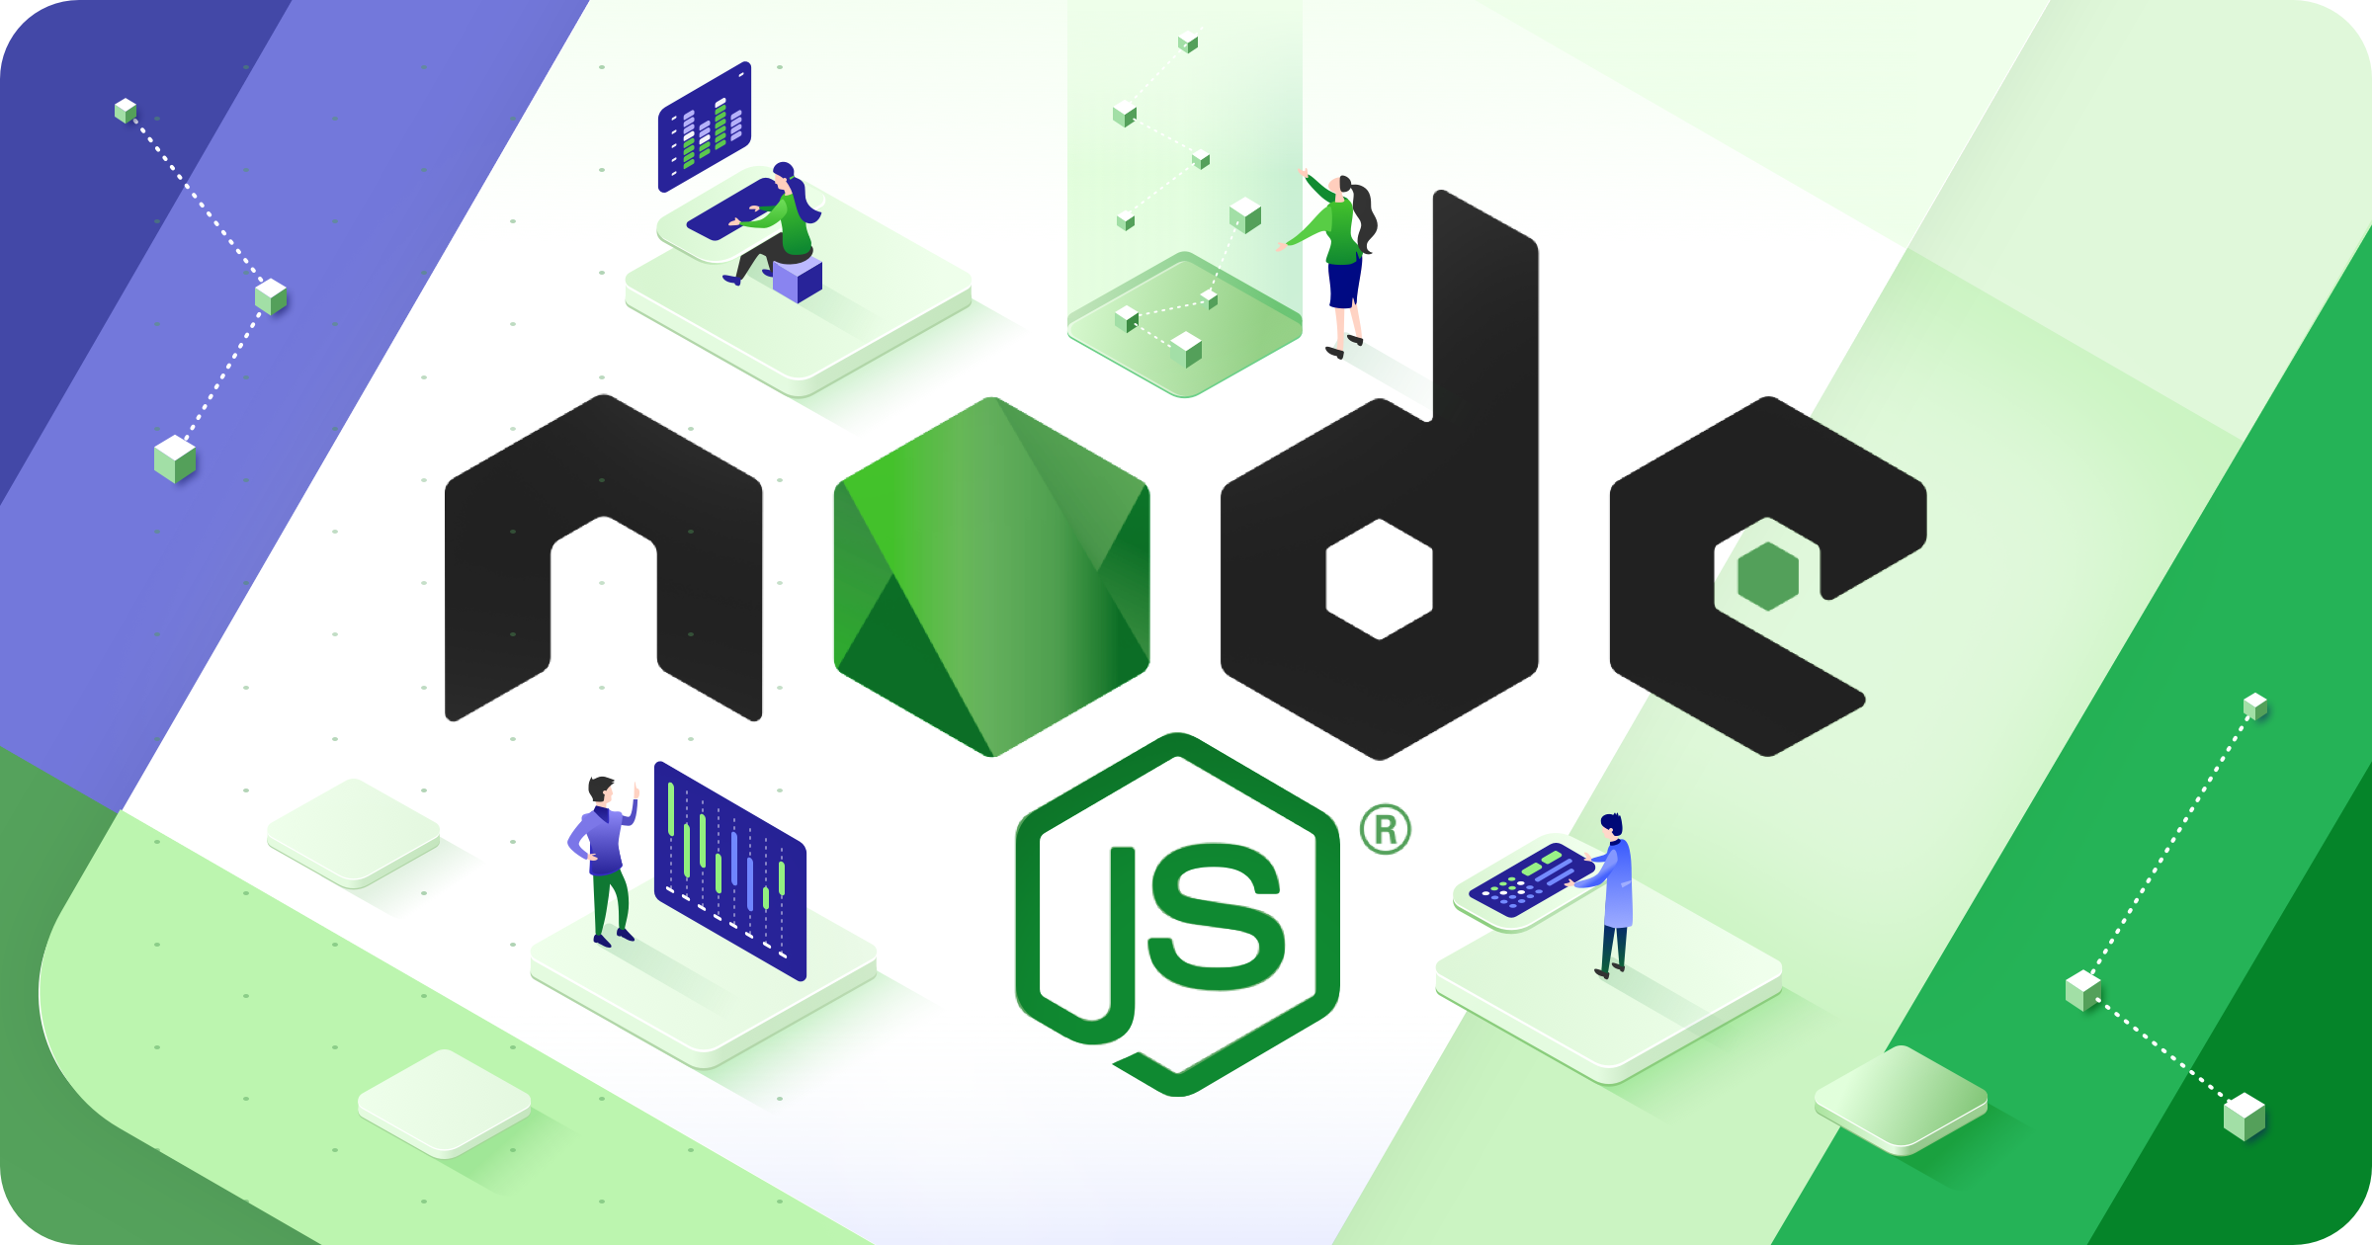

Slide 2
About Today…
Sync and Async Programming
Callback Functions
Promises and async/await
Practical Activity

Slide 3



Slide 4

Synchronous Programming
Operations are executed sequentially
Each operation waits for the previous one to complete before executing

Slide 5
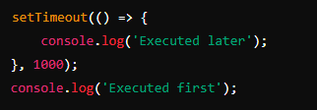
Asynchronous Programming
Operations can be executed concurrently
An operation does not wait for the previous one to complete
It improves efficiency

Slide 6
Importance of Async in Node.js
Node.js uses an event-driven, non-blocking I/O model, making it highly efficient for I/O-bound tasks
Asynchronous programming allows Node.js to handle multiple operations without blocking the main thread
It makes node.js suitable for real-time applications

Slide 7
Callback Functions

Slide 8
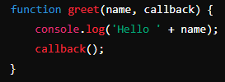



Introduction
A function passed as an argument to another function
This passed function is then invoked inside the outer function to complete some action

Slide 9
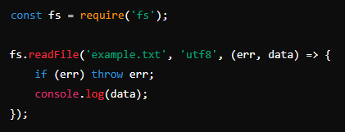
Example
Reading a File with fs.readFile

Slide 10
Promises

Slide 11
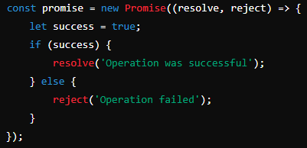
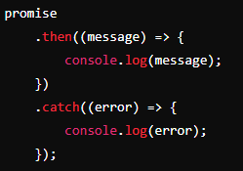
Introduction
An object representing the eventual completion or failure of an asynchronous operation

Slide 12
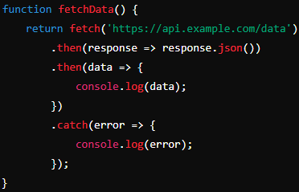
Example
Fetching Data Using Promises

Slide 13
Async / Await
Simplifying Asynchronous Code

Slide 14
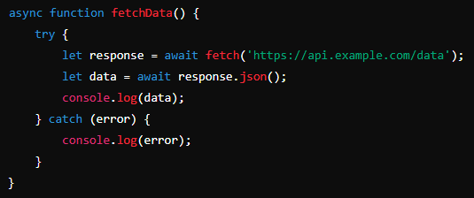

Introduction
Syntactic sugar over promises
Making asynchronous code look and behave more like synchronous code

Slide 15
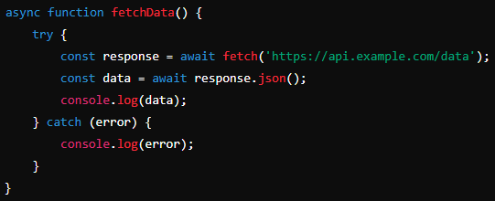

Example
Fetching Data Using Async/Await

Slide 16
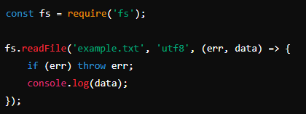
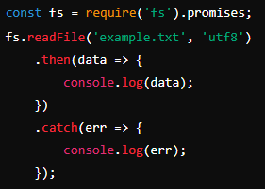
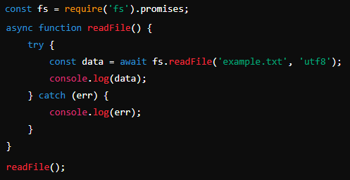
Practical Activity
Re-write this callback based function using Promises and async/await

Slide 17
Recap
Differences between synchronous and asynchronous programming.
The importance of asynchronous programming in Node.js.
Callback functions and their common use case.
Promises and async/await for managing asynchronous operations.
Practical activity: Converting callback-based code to use Promises and async/await.

